Slide 1

Survey of SAT & ACT entrance test in united states
BY Faiz puad

Slide 2


Problem statement
Mr. Abu recently got job offer and need to migrate to California, United States. His son, Samad just recently turn 17 years old and is migrating to US with him. Mr. Abu in dilemma to find best college to admit his son and how to secure place in that top flight college too. The goal of this survey is to find possible universities for Mr Abu’s son to enter with their requirement scores. This includes the best states with high entrance test scores to live in.
Use your duit raya la.
Can sell kidney too wat?
Pa, how can afford
flight ticket to US meh?

Slide 3

Exploratory data analysis
jom explore together!

Slide 4
Act vs sat
Entrance test relevant ?
01
Which test has highest participation and the reverse stats ?
02
Which school contained high scores mark student & which is most lenient ?
03
Which state pass with flying colour & which state does not ?
04

Slide 5
Background
51 states in US
Dataset use includes:
ACT Data (2017 & 2019)
SAT Data (2017 & 2019)
SAT & ACT By Intended College (2021)

Slide 6
Act data (2019 – 2017)
Participant
Contain 51 states
Mean participant is 0.59 – 0.65
Minimum participant is 0.06 – 0.08
Max participant is 1
Composite
Mean is 22 - 21
Minimum is 18 - 18
Max is 26 - 26

Slide 7
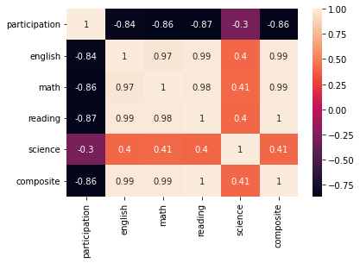
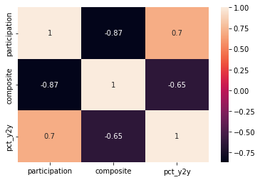
Act data year 2017 year 2019

Slide 8
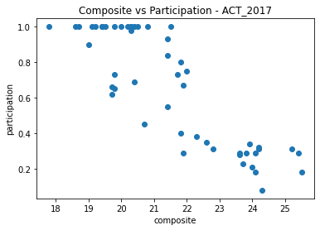
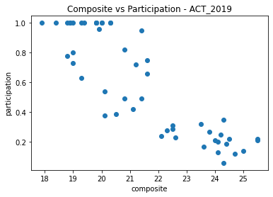
Act data year 2017 year 2019

Slide 9
SAt data (2019 – 2017)
Participant
Contain 51 states
Mean is 0.50 – 0.40
Minimum is 0.02 – 0.02
Max is 1
Total
Mean is 1113 - 1126
Minimum is 943 - 950
Max is 1284 - 1295

Slide 10
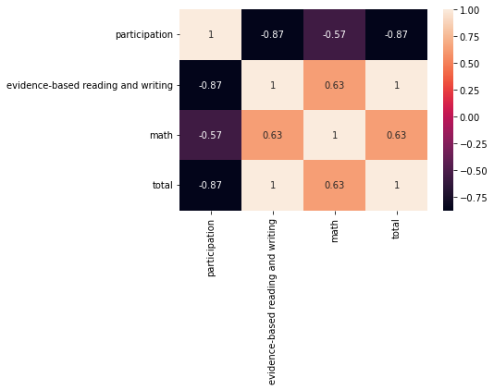
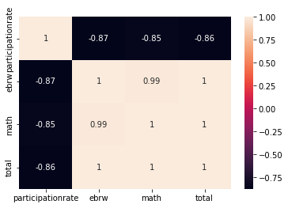
SAT data year 2017 year 2019

Slide 11
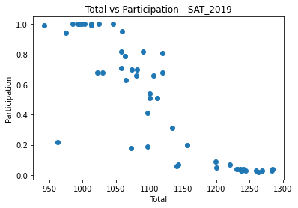
SAT data year 2019

Slide 12
SAT ACT STATS BY COLLEGE (2019 – 2017)
Applicants
Contain 416 college
Mean is 17482
Minimum is 211
Max is 111322
Accept Rate
Mean is 0.56
Minimum is 0.04
Max is 0.99
Total 25 percentile SAT - ACT
Mean is 1166 - 24
Minimum is 793 - 15
Max is 1530 - 35
Total 75 percentile SAT - ACT
Mean is 1358 - 30
Minimum is 1050 - 19
Max is 1580 - 36

Slide 13
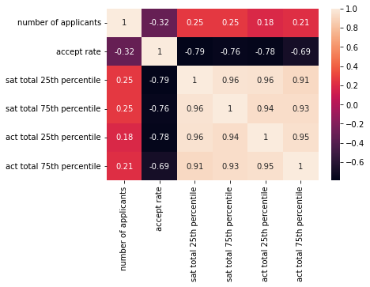
SAT ACT STATS BY COLLEGE

Slide 14
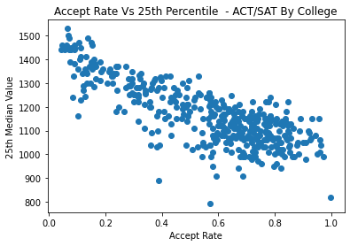
SAT ACT STATS BY COLLEGE year 2021

Slide 15
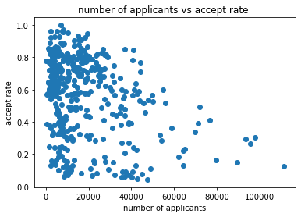
SAT ACT STATS BY COLLEGE

Slide 16
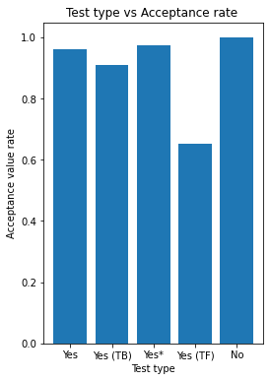
SAT ACT STATS BY COLLEGE

Slide 17
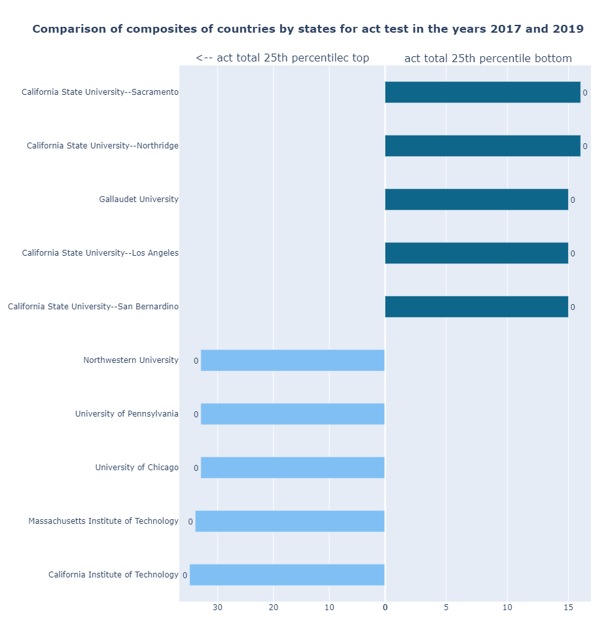
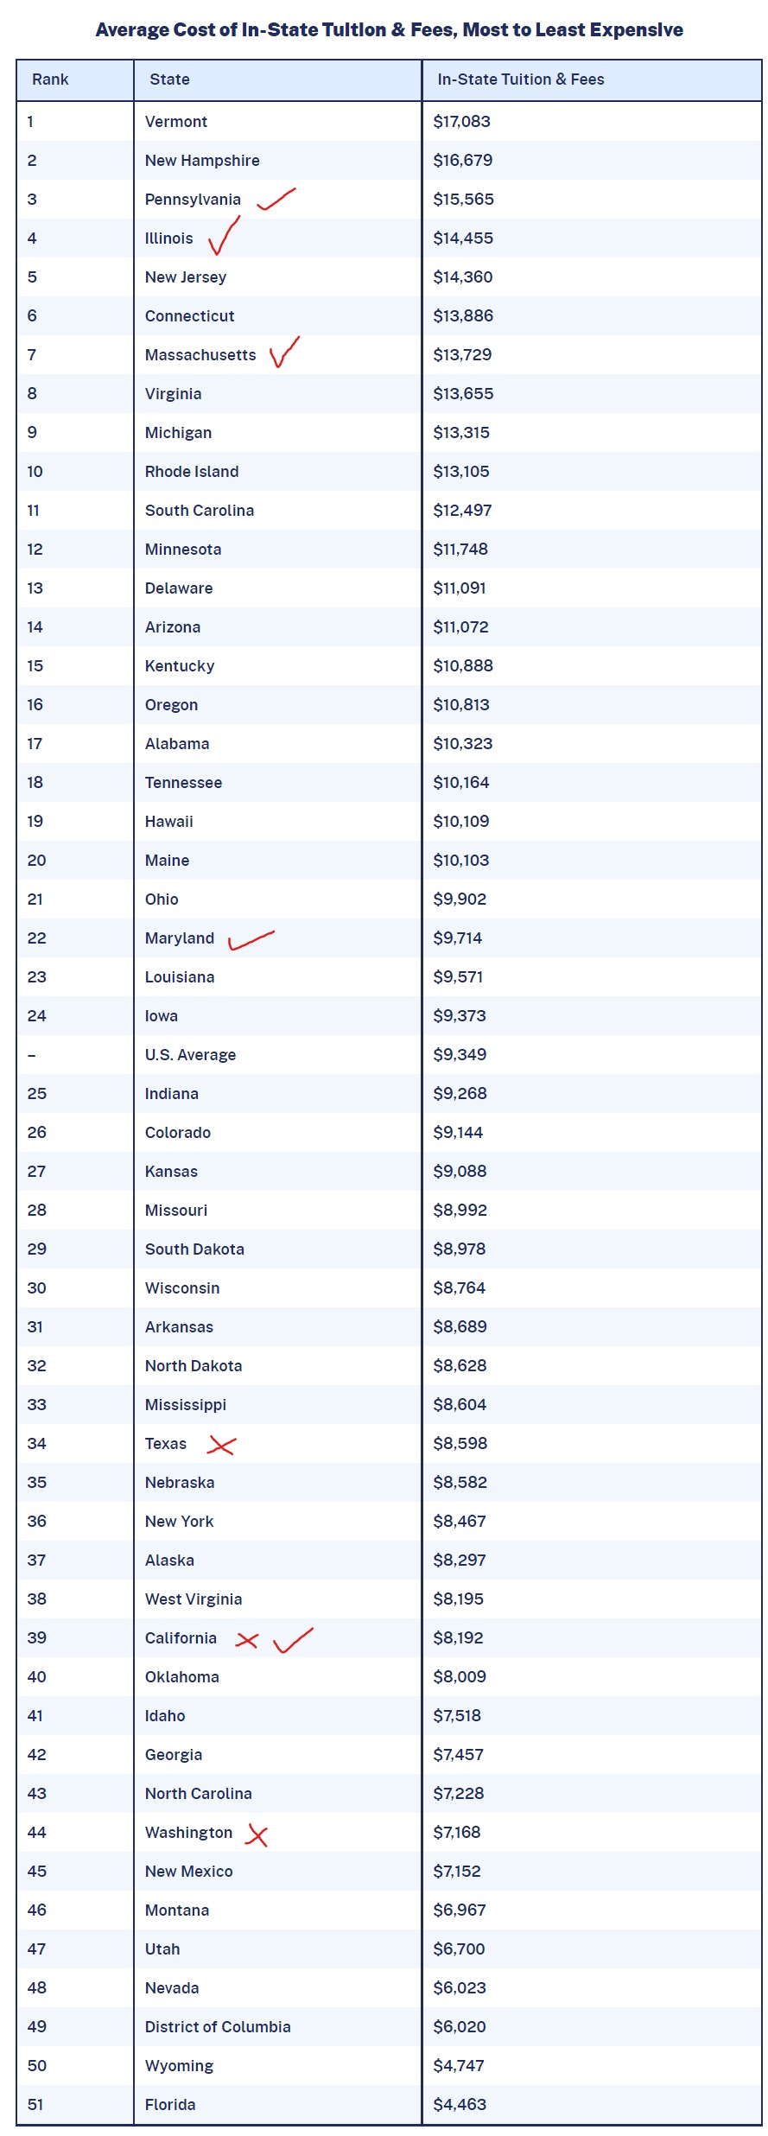
ACT STATS BY COLLEGE

Slide 18
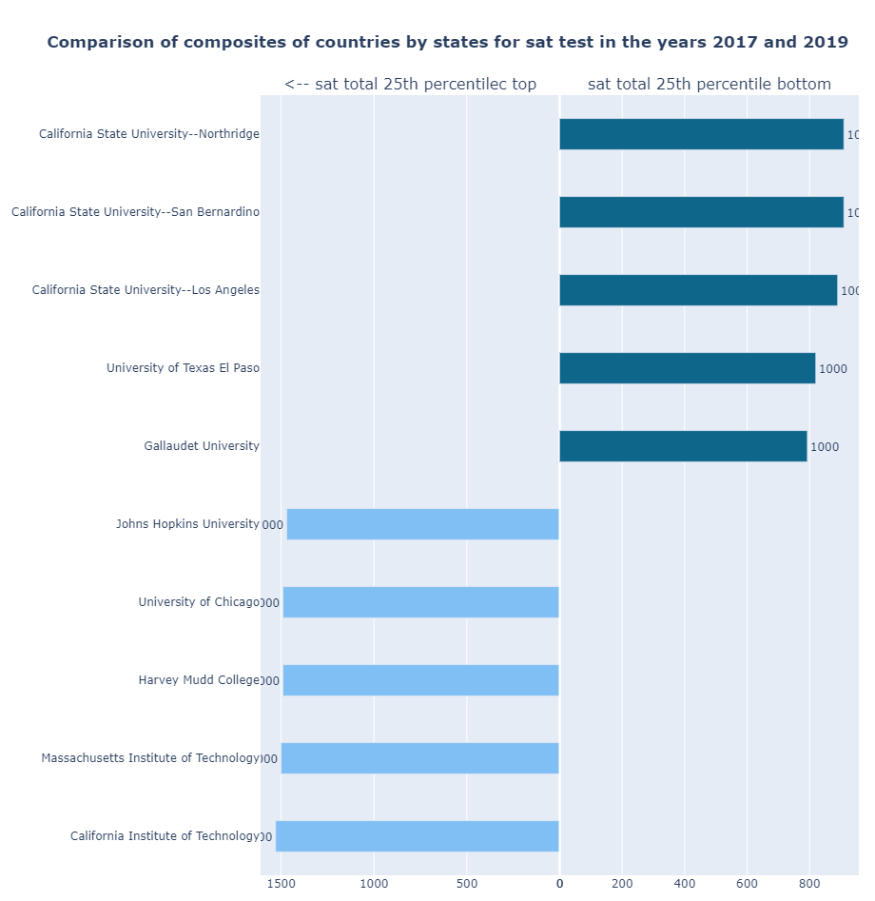
SAT STATS BY COLLEGE

Slide 19
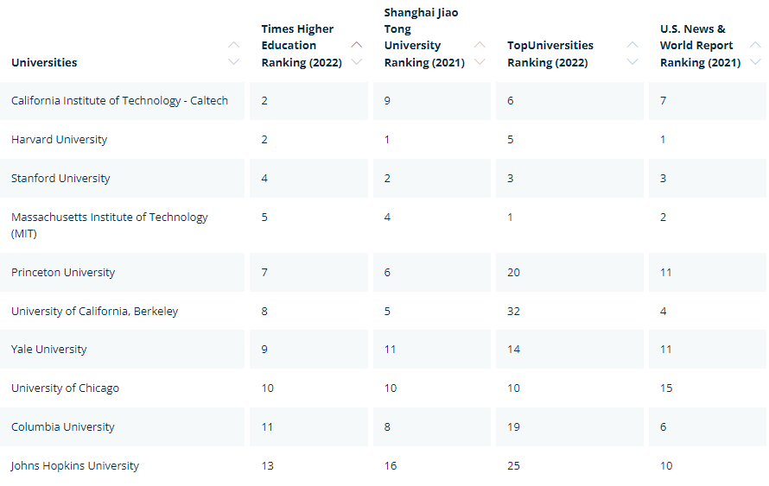

Slide 20

conclusions

Slide 21
Conclusion
at least median mark for scores to achieve
high living cost is also associate with stricter n more achiever result in that area
also choose school that is non optional test for higher chance
low participant school show greater marks in each test
sat has higher participation mean than act
cost of tuition fees, living, participation, lowest & ideal scores mark are recommended features for new student to consider when selecting which entrance test to pick for which type of college.

Slide 22
references
Universities Ranking
https://www.mastersportal.com/ranking-country/82/united-states.html
Average Cost of Tuition Fees of College in US’s state
https://educationdata.org/average-cost-of-college-by-state#:~:text=Massachusetts%20has%20the%20highest%20average,%2411%2C686%20per%20year%20on%20average.
Annual Average Cost of Living in States of US
https://meric.mo.gov/data/cost-living-data-series

Slide 23

Thank you

